Slide 1




AI
GEN Z
PERSONALIZATION
CONSUMER INSIGHT
by Lashawn Fofung
Notes:
Hello Everyone. I want to start with a quote from a 22-year-old survey respondent: 'I wish news apps would do what Spotify does—actually learn what I care about.' This simple statement encapsulates our core problem: Gen Z is accustomed to personalization magic, but they feel news apps are giving them a generic experience. We are here today to resolve that gap.

Slide 2
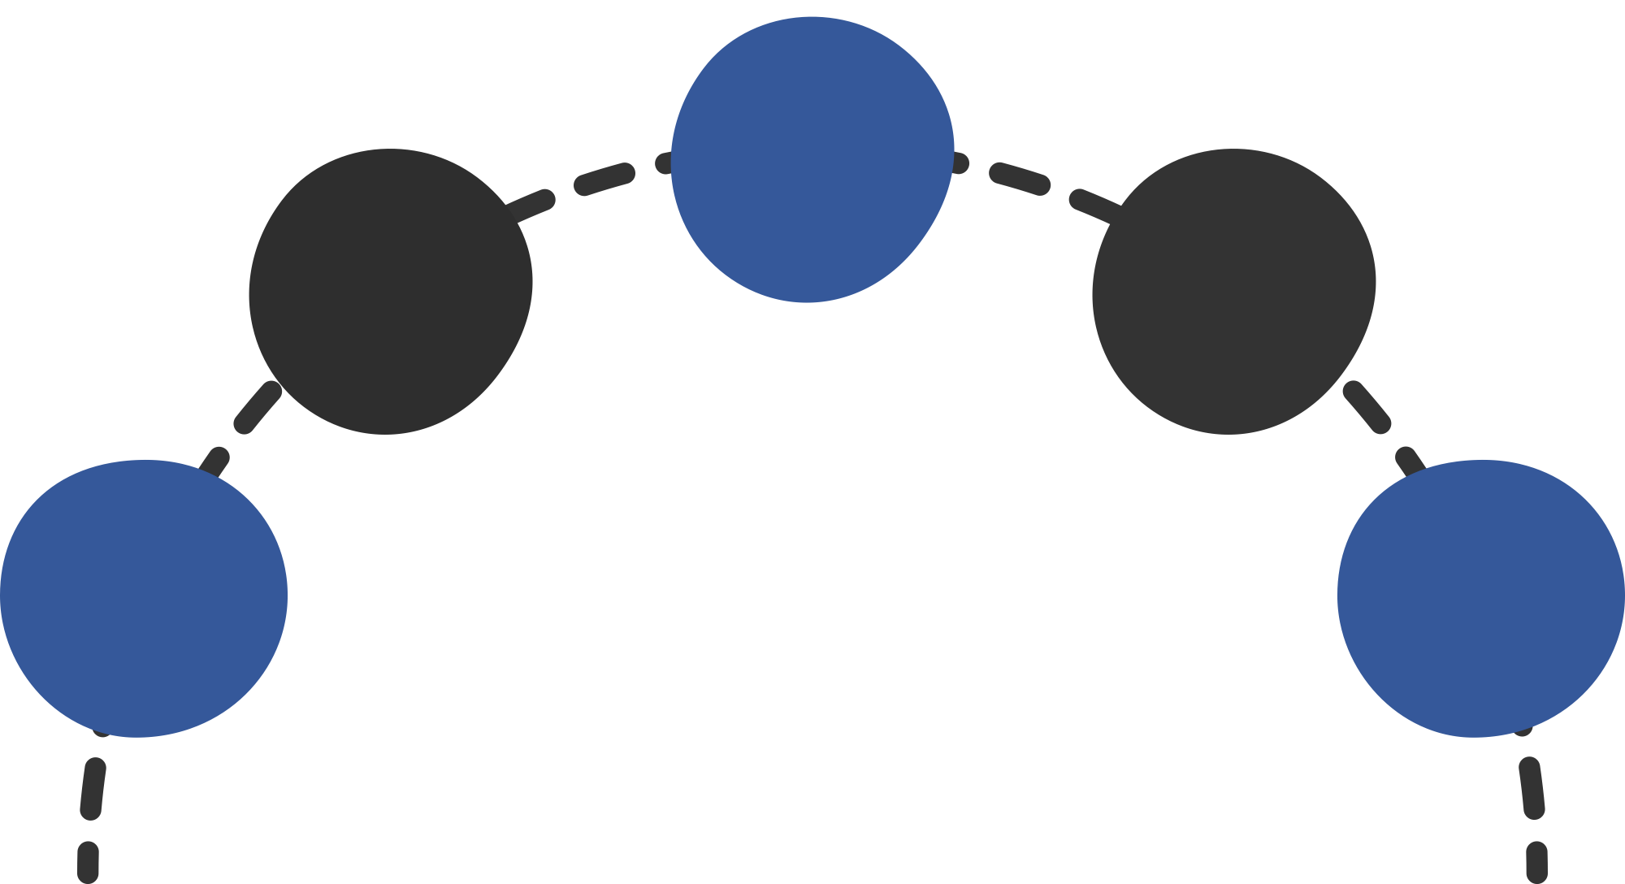
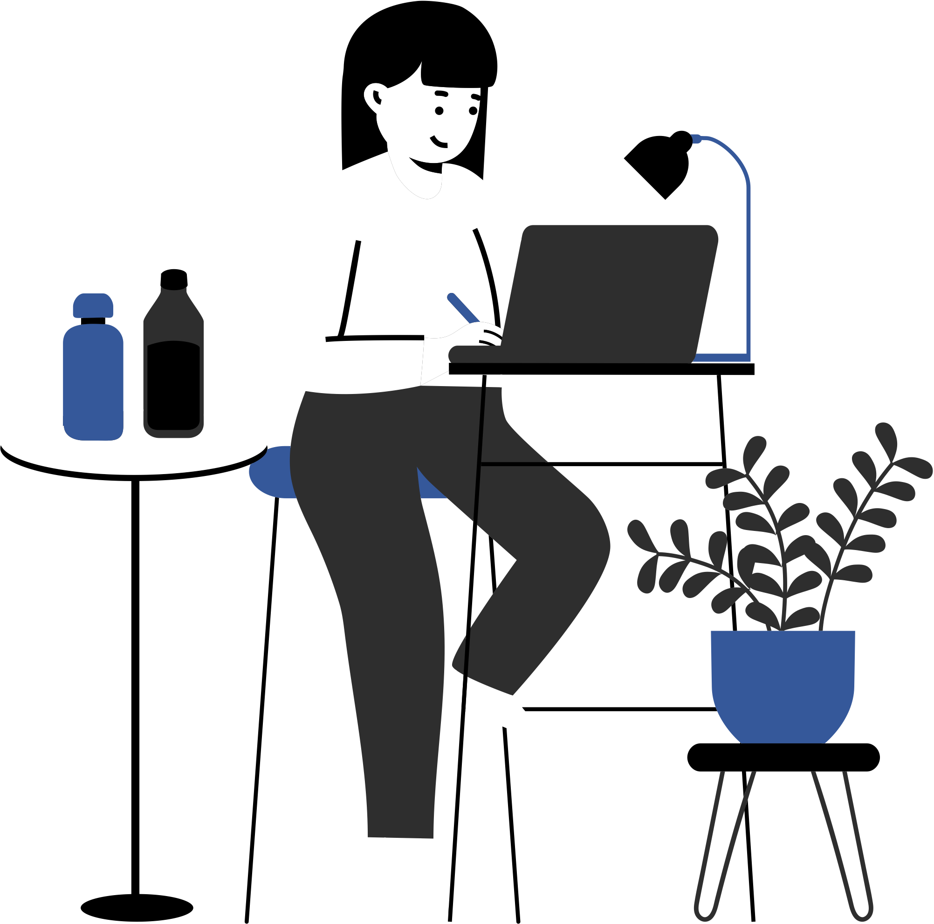
Gen Z
Problem
Lack of Transparency
Preference for Control
A desire of transparency is evident, with 15 out of 19 respondents (79%) selecting “Very important” or “Somewhat important” when asked how important it is to know why a story is being recommended.
When it comes to personalization, 7 out of 19 respondents (37%) prefer to "pick my own topics or sources" or rely on the system learning from their behavior ("I like the app or website to learn from my behavior"). However, the majority, 8 out of 19 (42%), want a "mix of both" or say "It depends on the app or website", indicating a need for flexible, user-controlled systems.
The “Filter Bubble” Fear
3
Users express a wish for the news apps to be “less biased” and include a “mix of varying opinions.” They also want mix of expected content and “something I didn’t know or didn’t expect.”
2
4
Ineffective
Personalization
Trust Crisis
A significant portion of users report not noticing or using personalized features, with 4 out of 19 respondents (21%) saying they “Never” notice or use personalized features in news apps/websites.
A high level of distrust exists regarding data usage for personalization where 8 out of 19 respondents (42%) state they “I don’t trust them at all” or “I have little trust in them” to use their data responsibly.
1
5
Notes:
Note: next few slides will cover Act 1 of three phase presentation on consumer insight.
ACT 1: The User Problem (The Setup)
Our research confirms we have an immediate problem, defined by five major frictions: 1. Ineffective Personalization. A stunning 26% of Gen Z users report they never notice or use personalized features. 2. The Trust Crisis. They are highly skeptical, leading to a 42% trust deficit in news apps using their data responsibly. 3. Lack of Transparency. They want to know why they see a story—79% say this is important. We are losing the attention and the trust of a generation that values digital relevance above all else.

Slide 3
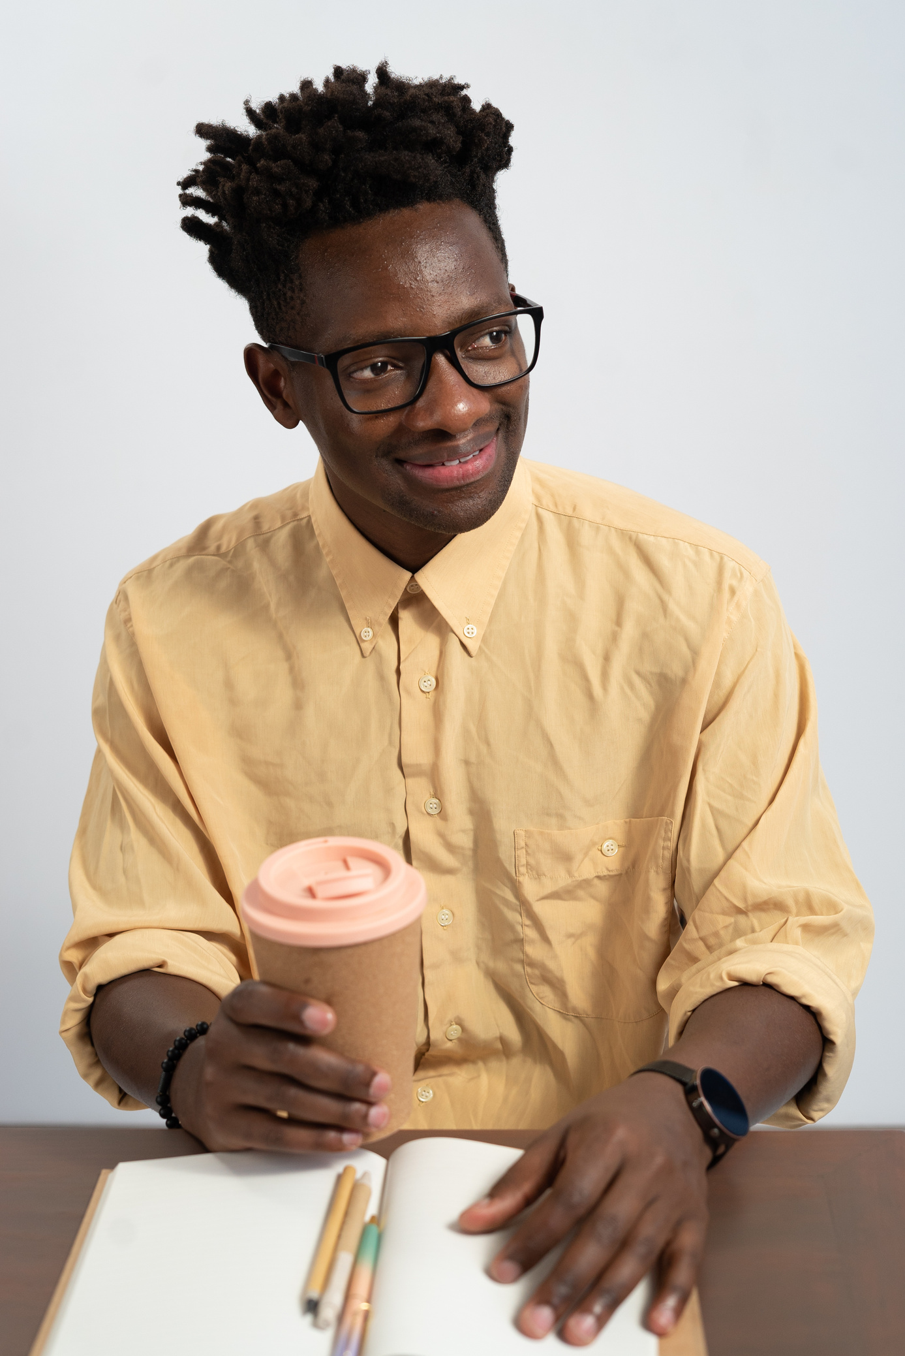
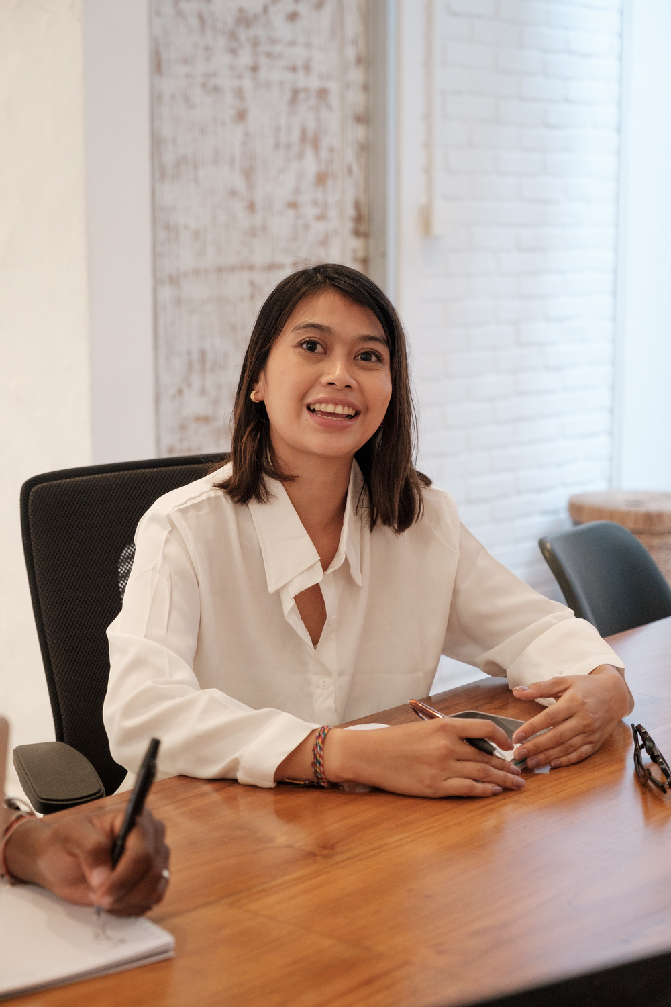

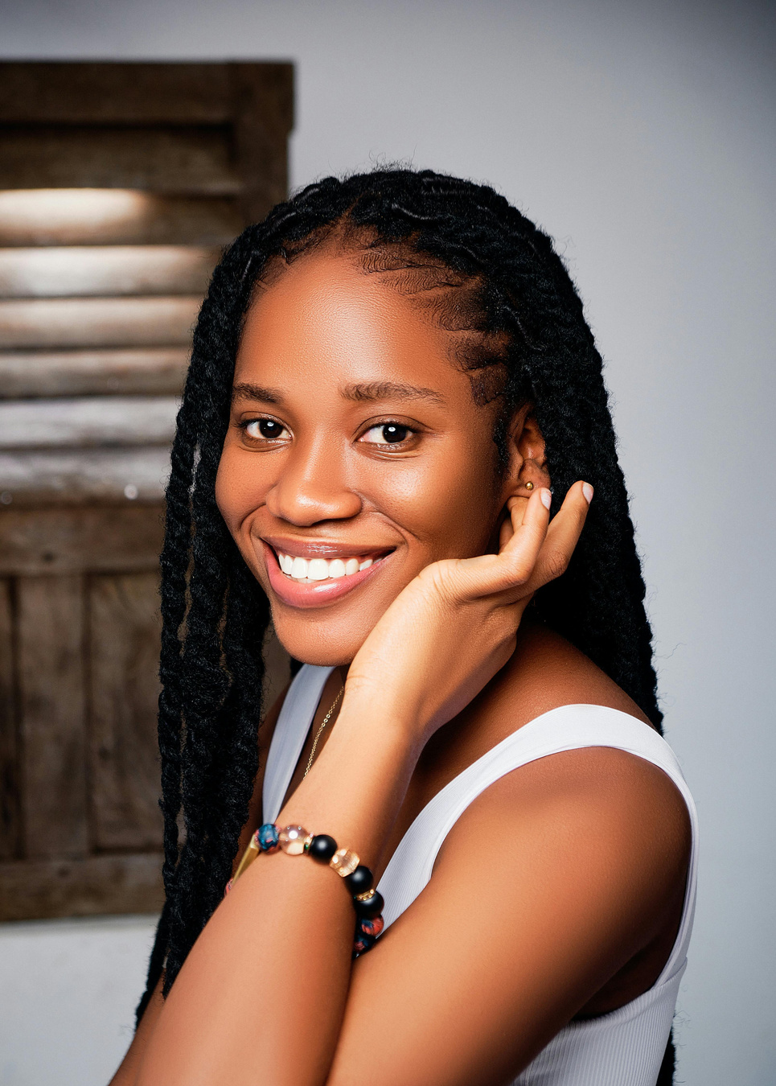

User Personas
Gen Z
Notes:
To understand the why behind the numbers, we met four personas.

Slide 4
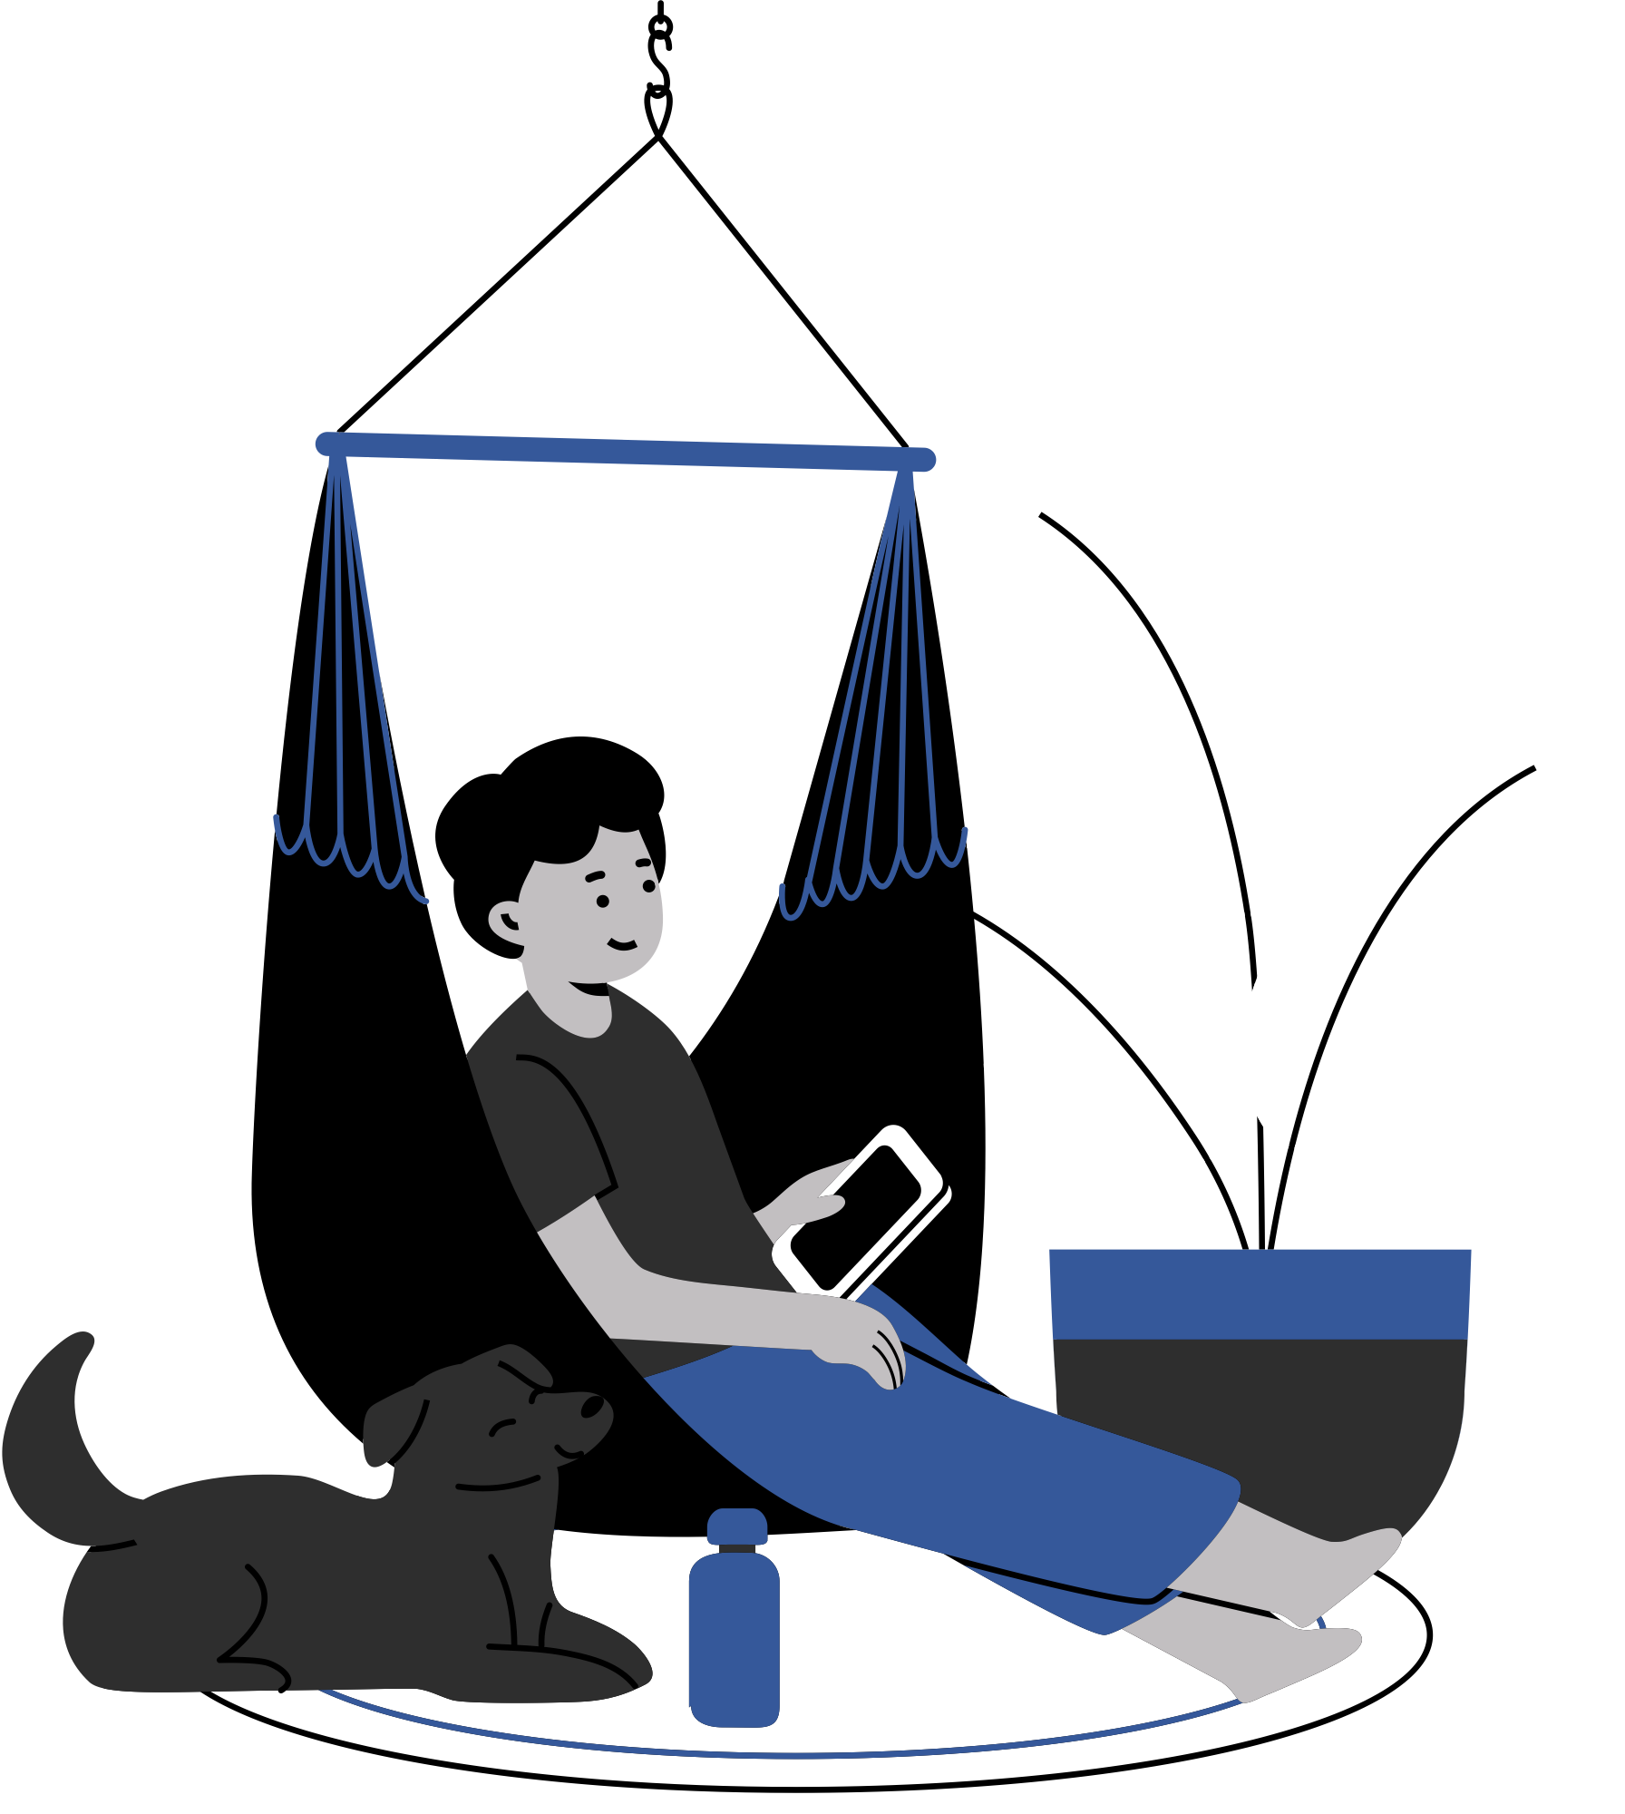

Gen Z
Top
Platforms
Audience
The most-used platforms in the last 3 months are YouTube (16 out of 19, or 84%), Netflix (13 out of 19, or 68%), and Instagram (15 out of 19, or 79%).
News
Consumption
News is primarily consumed via Social media (like Instagram, Reddit, TikTok, etc.) by 17 out of 19 respondents (89%). Podcasts or YouTube is the second most popular news source (10 out of 19, or 53%).
Age
&
Employment
The vast majority of eligible respondents are in the 18-24 age group (13 out of 19, or 68%) and are currently Students (14 out of 19, or 74%).
Notes:
Our audience is young (majority 18-24 students), and their news default is Social Media (89%), with YouTube and Instagram being their top platforms overall. They are power-users of highly personalized entertainment, making our failure to deliver relevant news even more glaring.

Slide 5
BACKGROUND
PERSONAL CHARACTERISTICS
HOBBIES AND INTERESTS
Jerry is a US student who primarily uses social media for news. He's a frequent streamer (About once a week) but wants news apps to be more balanced. He's highly aware of algorithms and wants transparency.
  Media-Literate
  Idealistic
  Community-Oriented
  Skeptical of authority
  Seeks Fairness
  Debating current events (online/in-person)
  Long-form podcast consumption
  Following political/social commentary
  Casual gaming (for social interaction)
JERRY
WATCHES NEWS ONLINE
GOALS
CHALLENGES
About Once A Week
  Find balanced
  High-Quality News
  Variety of perspectives
  Too biased news feeds
  Not enough diverse viewpoints
  Age: 22 years old
  Country: US
  Profession: Student
TOP PLATFORMS
NEEDS
SOURCES OF INFO
YouTube (for deep-dives), Instagram, TikTok
  Actively promotes diverse or opposing viewpoints
  Transparency on why he’s seeing a story.
  Reddit
  Podcasts
  Instagram
  TikTok
"I could only wish that news apps were less biased and pour in a mix of varying opinions in my feed."
Notes:
Jerry is the skeptic who fears the 'filter bubble' and demands less bias and more fairness.

Slide 6
BACKGROUND
PERSONAL CHARACTERISTICS
HOBBIES AND INTERESTS
Alice is a heavy user of streaming and social media, noting a personalized experience on Netflix, YouTube, and Instagram. She notices and appreciates personalization but is highly distrustful of news apps' use of her data. She prefers a mix of picking her own topics and letting the app learn.
  Pragmatic
  Content-Loyal
  Efficiency-Focused
  Trend-Aware
  Values Curated Quality
  Subscribing to niche YouTube channels/creators
  Following food or travel blogs
  Fitness tracking and wellness
  Curating digital playlists (e.g. Spotify)
ALICE
WATCHES NEWS ONLINE
GOALS
CHALLENGES
Every day
  Get relevant & curated news
  Get news similar to her personalized content feeds
  Doesn’t trust news apps with her data
  Wants content from familiar, subscribed sources she trusts
  Age: 27 years old
  Country: US
  Profession: Marketing Director
TOP PLATFORMS
NEEDS
SOURCES OF INFO
YouTube, Netflix, Spotify
  Features that prioritize creators
  Sources she actively follows
  Clear data privacy controls
  Podcast
  YouTube
“Recommend more content from creators who I’m subscribed to.”
Notes:
Alice is the pragmatist who trusts her favorite content creators more than the app itself.

Slide 7
BACKGROUND
PERSONAL CHARACTERISTICS
HOBBIES AND INTERESTS
Derek is a self-proclaimed heavy social media user for news. He notices personalized recommendations "Often" but "I don't trust them at all" with his data. He is a critical consumer demanding full transparency and an escape from algorithmic bias.
  Privacy-Conscious
  Analytical
  Critical Thinker
  Tech Enthusiast
  Highly Skeptical
  Reading non-fiction deep-dives/long-form journalism
  Following tech reviewers and news gadgets
  Online security/privacy forums
  Building or customizing his computer/digital setup
DEREK
WATCHES NEWS ONLINE
GOALS
CHALLENGES
A few times a week
  Access personalized news without feeling manipulated
  Access personalized news without having his biases reinforced
  Total lack of trust in news apps’ data practices
  Overwhelmed by low-quality or biased news
  Age: 22 years old
  Country:US
  Profession: Student
TOP PLATFORMS
NEEDS
SOURCES OF INFO
YouTube, Reddit, Chrome (Direct Website Access)
  Clear, detailed explanations for why an article is shown (transparency tag)
  Tools to actively combat algorithmic bias
  News websites via browser
  YouTube
  Instagram
  Reddit
  TikTok
"More transparency, less bias enforcement"
Notes:
Derek is the critical thinker with zero trust, demanding full transparency on data use.

Slide 8
BACKGROUND
PERSONAL CHARACTERISTICS
HOBBIES AND INTERESTS
Janice is a power user of social media and streaming who notices personalization "Always". She has actively personalized her news feed before and wants to personalize nearly every aspect of the news experience for maximum efficiency and relevance.
  Highly Organized
  Digital Power User
  Efficiency-Obsessed
  Detail-Oriented
  Demanding of UX
  Planning intricate trips using detailed spreadsheets
  Organized her digital life (e.g.,app folders, file systems)
  Learning new languages
  Using productivity/automation tools
JANICE
WATCHES NEWS ONLINE
GOALS
CHALLENGES
Every day
  Full, granular control over her news consumption experience
  Make user experience highly efficient and tailored to her need for moment-by-moment
  Apps don’t offer enough granular customization options for the news experience
  Age: 26 years old
  Country: Malaysia
  Profession: Student
TOP PLATFORMS
NEEDS
SOURCES OF INFO
Instagram, Telegram (Messaging), YouTube
  A comprehensive “My Feed Settings” panel with options to customize everything from content mix to tone
  Reddit
  TikTok
  Podcasts
  YouTube
  Messaging Apps
“My focus is on feature control. I want my personalization to be focused on Topics, Length, Format, and Tone.”
Notes:
Janice is the power user who wants to personalize everything—not just topics, but length, format, and tone.
The common thread for all four personas:
They all reject the passive, generic feed.

Slide 9




Consumer Insight
AI Personalization
Survey
The survey collected 20 total responses from young adults, primarily aged 18-29, to understand their use of AI-powered features. Its goal was to gather feedback for improving news products, focusing on topics like news consumption habits and the awareness of AI algorithms. The key areas of inquiry were users' levels of trust in personalization and their preferred customization options.
Google Forms
Reddit, LinkedIn, Instagram
Notes:
ACT 2: Evidence from Data (The Investigation)
We collected 20 responses from the target demographic (18-29) focusing on their awareness, trust, and preferences regarding AI features.

Slide 10
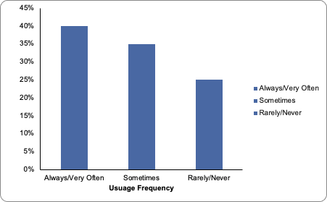
The Personalization Paradox
While the majority of users (65%) see personalization features, a significant quarter of users (25%) state they never even notice or use them. This confirms that in news apps, current AI personalization is largely invisible or ineffective. AI Personalization is failing to register with a critical segment of the Gen Z audience.
Notes:
This slide shows the paradox: 65% of users see personalized features 'Always' or 'Often,' yet 25% report they never notice them.
This confirms our personalization is invisible or ineffective. We are investing in features users aren't even aware of.

Slide 11
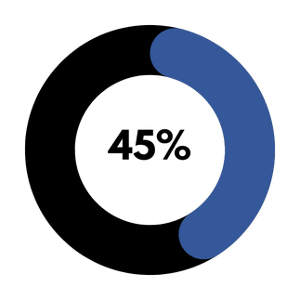
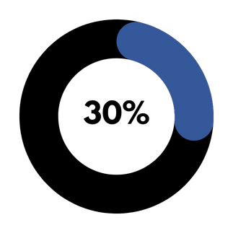
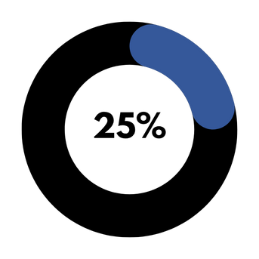
Preferred Personalization Approach
The preferred approach is a "Mix of Both" (25%), or a combination of picking topics/learning from behavior/it depends on the app, totaling 75%. This shows a clear desire for co-piloted personalization, where the user maintains control while benefiting from algorithmic discovery.
Manually Set
App to Learn & Auto-Adjust
Mix of both
(Manual & Auto Adjusting)
Notes:
When we asked users how they actually prefer their personalization to work, we found something surprising that validates our shift toward control.
Nearly half of our audience—45%—prefers to manually set their own topics or sources. They want to be the editor-in-chief of their own feed. This is a clear signal that current passive, algorithmic-only systems are failing.
Contrast that with the 30% who favor the app learning and auto-adjusting from their behavior. This group trusts the algorithm, but it's the minority.
The remainder, 25%, want a mix of both.
This data proves that Gen Z rejects the black box approach. They want a co-piloted experience where they maintain control, actively inputting their preferences,
while the AI does the heavy lifting in the background. Our product must reflect this desire for manual authority.

Slide 12
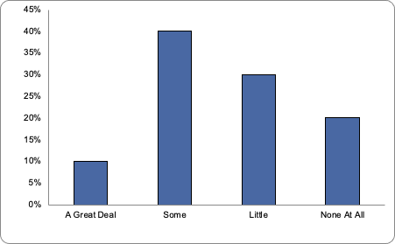
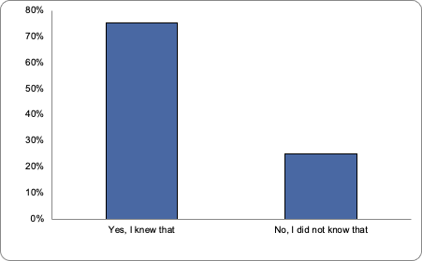
The Trust Deficit
A strong majority of Gen Z users (75%) know that algorithms decide what news they see, yet 50% hold the lowest levels (Little/None) of trust in news apps to use their data responsibly for personalization. This is a crisis of trust for an audience that is highly aware of the systems at play.
Notes:
The skepticism is real. While 75% of users know algorithms drive their news, 50% place low or no trust in our ability to use their data responsibly.
We are operating in a trust crisis built on opacity.

Slide 13


AI Dimensional Personalization
User Problem
Goal
Gen Z distrusts the "black box" of news personalization: 50% have low trust, and 26% never notice the features.
Personalization by adapting news feeds based on three critical factors: Location, Length/Depth, and Format (Photo/Video priority).
HYPOTHESIS
Next Steps
Core Insight
Prototype & Test these dimensional controls. Measure their impact by reducing the 26% `Never Notice` score and increasing the Trust Score.
Users demand granular, functional control over how content is delivered, specifically Length (10 respondents) and Format (9 respondents).
Notes:
Our data confirms two critical problems: distrust and invisibility.
First, the User Problem: Gen Z distrusts the current 'black box' approach. Over 50% have low trust, and crucially, 26% of users never even notice the personalization we're building.
The features are ineffective because they are invisible.
But the Core Insight offers a way forward: Users are demanding granular, functional control. They don't just want us to pick topics; they want control over the delivery of the news, specifically article length and media format. This is the key to creating a truly useful news product.
Therefore, our Goal is to launch AI Dimensional Personalization. This means our AI will shift its focus entirely.
Adapting feeds based on the critical factors of Location, Length/Depth, and Format priority (Photo/Video).
This is how we provide functional value that Gen Z expects from all their digital platforms.
The Next Step is clear: We must prototype and test these controls immediately.
We will measure success by eliminating the user pain points: reducing the 26% 'Never Notice' score and actively increasing our overall Trust Score.

Slide 14


Product Feature
Recommendation
Notes:
This brings us to our hypothesis: The AI model must pivot from merely choosing 'What topics?' to delivering 'How, where, and when’.
We will implement AI Dimensional Personalization—adapting news feeds based on Location, Length/Depth, and Format—to transform the black box into a trustworthy co-pilot.

Slide 15
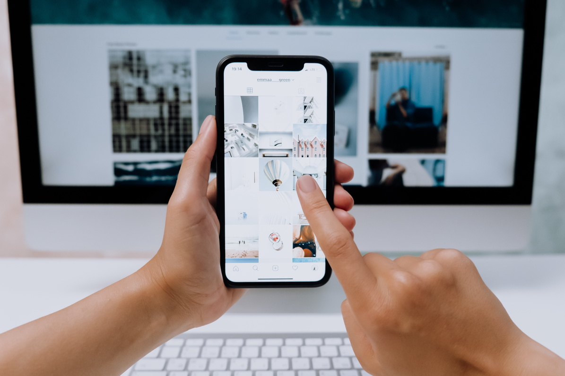
High Impact UX
Friction Zones
AI Dimensional Personalization
Section | Layer | What Gen Z Tries To Do | Friction | User Sentiment | Design Fix
Invisibility & Trust | Discovery Layer | Assess if the news feed is relevant/personalized, and why. | Personalization features (Like a “For You” tab) are too generic or buried, making the AI’s effort invisible (26% never notice). | "I wish news apps would do what Spotify does. Actually learn what I care about.” | Transparency X-ray 🧐 Add a subtle clickable “i” icon that instantly explains the core AI reason fr the story’s placement.
2. Time & Depth | Content Layer | Find a news story that perfectly matches their current attention span (e.g., a quick update vs. a deep dive). | The feed mixes article lengths randomly, forcing the user to waste time tapping and leaving articles that are too long or too short for the moment. | 10 respondents cited Length or depth as a desired customization. | Length Toggles ⏱️ Implement a persistent, AI-powered toggle (like "Brief" / "In-Depth") that filters the feed instantly by predicted reading time.
3. Media & Context | Format Layer | Get news in the format best suited for their environment (e.g., on-the-go audio vs. at-home video). | The feed defaults to text, failing to prioritize video/audio even when the user has shown a clear preference for streaming/YouTube. | 9 respondents cited Format (text, video, audio) as a desired customization. | Format Prioritization 🎬 A simple feed setting that uses AI to elevate video/photo stories above text when the user has set a preference for visual content.
Notes:
Our vision is clear: Implement transparent, user-controlled personalization that gives Gen Z the algorithmic relevance they expect, paired with the editorial credibility they need.
We are focusing on three high-impact design fixes that directly resolve the core user friction points.
We are targeting three major friction points with three core fixes:
Friction: Invisibility & Trust. Users don't know why they see what they see.
Design Fix: The Transparency X-Ray. A clickable icon that shows the AI’s reasoning (e.g., 'Recommended because you follow Tech News').
Friction: Time & Depth. Users waste time clicking long articles when they only want a summary.
Design Fix: Length Toggles. Persistent toggles (e.g., 'Brief' / 'In-Depth') that use AI to instantly filter content to match their attention span.
Friction: Media & Context. Users prefer video or audio but are stuck with a default text feed.
Design Fix: Format Prioritization. A simple setting that tells the AI to elevate video or photo content in the feed.

Slide 16
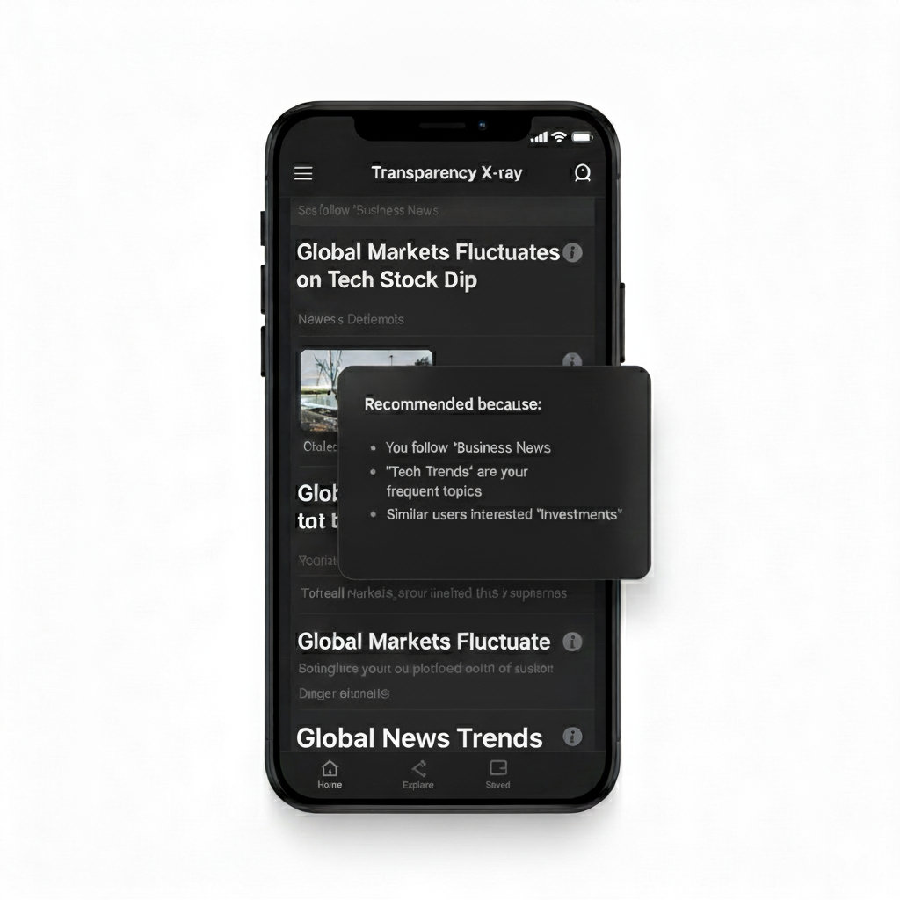
Transparency X-Ray
Mockup
This image shows a news feed with a specific article highlighted, and a pop-up window explaining why that article was recommended to the user.
Defining Success Metrics
Success Metric
User Trust Score (Dimensionally): Increase the percentage of users who express moderate or high trust in the app's use of their data.
How to Measure
  Future Survey: Rerun Q21 (Trust in news apps) and add: "Did the 'Why This Story?' tag increase your faith in the app's fairness?"
  Target: +15% in "Trust Somewhat/A lot" responses.
Notes:
This isn't just a design exercise; it's a measurable product strategy.
To measure the Transparency X-Ray, we will track the User Trust Score.

Slide 17
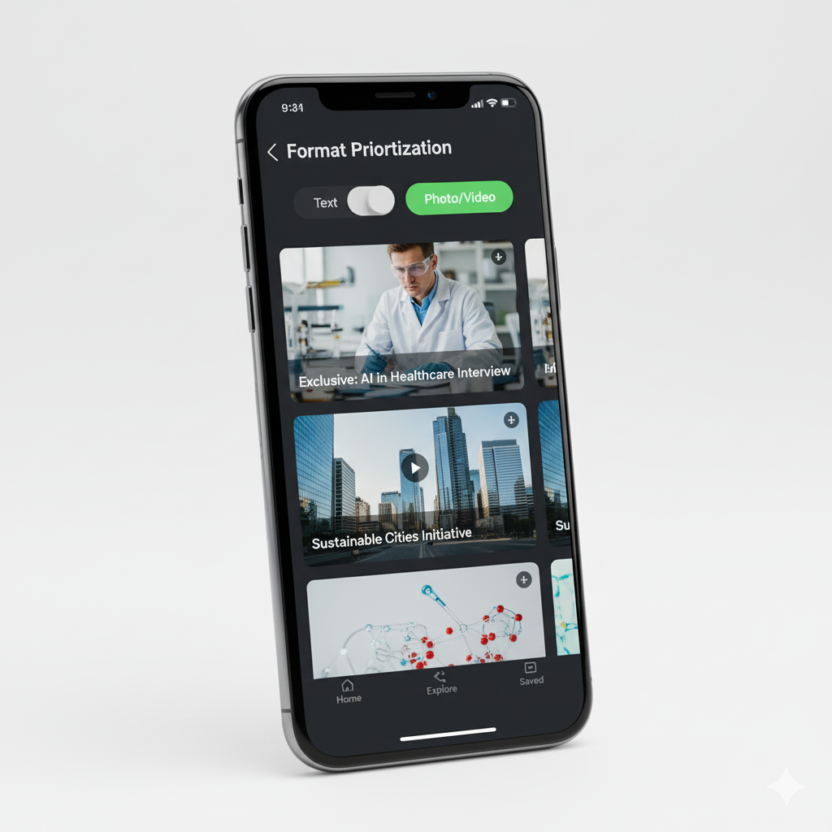
Format Prioritization
Mockup
This image shows a news feed with a toggle to prioritize content format (e.g., "Text" vs. "Photo/Video"), immediately adjusting the display to show more visual content.
Defining Success Metrics
Success Metric
Engagement Rate on Preferred Format: Measure how frequently users consume (click or view) articles in their explicitly set preferred format (Video/Photo).
How to Measure
  Analytics: Track Click-Through Rate (CTR) on visual content among users who have set a "Photo/Video Priority" preference.
  Target: +10% CTR on video/photo articles compared to users on the default feed.
Notes:
To measure Format Prioritization, we will track the Engagement Rate on Preferred Format, targeting a 10% higher CTR on video/photo content.

Slide 18
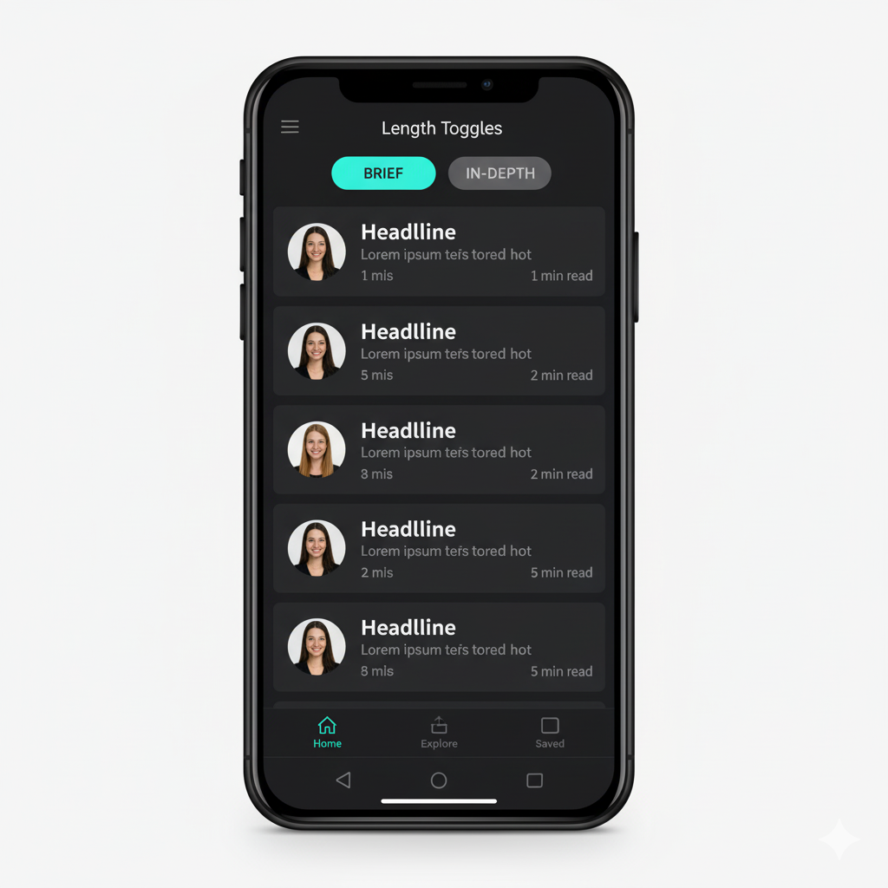
Length Toggles
Mockup
This image shows a news feed with clear toggle buttons at the top, allowing the user to filter the displayed articles by their desired length (e.g., "Brief" or "In-Depth").
Defining Success Metrics
Success Metric
Time-to-Content Success Rate: Measure how often users successfully find a story of their desired length on the first click.
How to Measure
  Analytics: Track the App Exit Rate after a user applies the "Brief" or "In-Depth" toggle.
  Target: Reduce the exit rate by 10% compared to the uncontrolled feed.
Notes:
To measure Length Toggles, we will use analytics to track the App Exit Rate after using the filter—lower exits mean higher content success.

Slide 19
Key Takeaways
  Personalization Failure & Trust Crisis:
    Current news AI is largely invisible and ineffective, resulting in 26% of Gen Z users never noticing personalized features and contributing to a 42% trust deficit compared to social/streaming platforms.
  Demand for Dimensional Control:
    Gen Z is moving past simple topic filtering and demands functional control over the content's delivery dimensions.
  The Strategic Shift:
    he focus must pivot from merely answering "What topics?" to dynamically adapting the news experience based on "How, where, and when," by personalizing factors like article length, media format, and user location.
Notes:
To close, our project is summed up simply: Personalization is currently failing, leading to both an invisibility problem and a trust crisis.
We are resolving this with AI Dimensional Personalization—a set of three key features focused on Transparency, Length, and Format.
Our immediate next step is to prototype and test these solutions.
By doing this, we move from being a black box to a trustworthy co-pilot, securing the next generation of news consumers.

Slide 20
AI
PERSONALIZATION
THANK
GEN Z
YOU
Notes:
Thank you.

